Slide 1



Aviva Smart Health
Looking after you – with Aviva Smart Health

Slide 2
Let’s talk about health and wellbeing
Aviva Smart Health
Notes:
Notes to speaker:
Please start here if you want to start this conversation with a more general chat about health and wellbeing
Introduce the topic of health and wellbeing in your workplace − we know it’s something people want to hear about. Over two-thirds of employees have said they want to engage with health and wellbeing initiatives¹
Acknowledge that things have been tough over the past few years − the cost of living crisis (e.g. We know everyone has money worries at the moment), rising levels of poor mental health, coronavirus etc. Here’s a few facts to throw in there, but feel free to add some of your own personal references and stories in too.
77% of people are either worried or very worried about the impact of the cost of living on their life²
Around a third of people said their mental health has got worse since the first wave of the Covid pandemic in March 2020³
Start off by talking about what you’ve been doing in your workplace so far − have you introduced wellbeing days? Offered access to services for your people? Done surveys to gather thoughts and opinions? Shared advice and information on coping strategies?
¹ CIPD, April 2021
² Gov.uk, June 2022: https://www.ons.gov.uk/peoplepopulationandcommunity/wellbeing/articles/worriesabouttherisingcostsoflivinggreatbritain/apriltomay2022
³ Mind, last accessed October 2022: https://www.mind.org.uk/coronavirus-we-are-here-for-you/coronavirus-research/

Slide 3
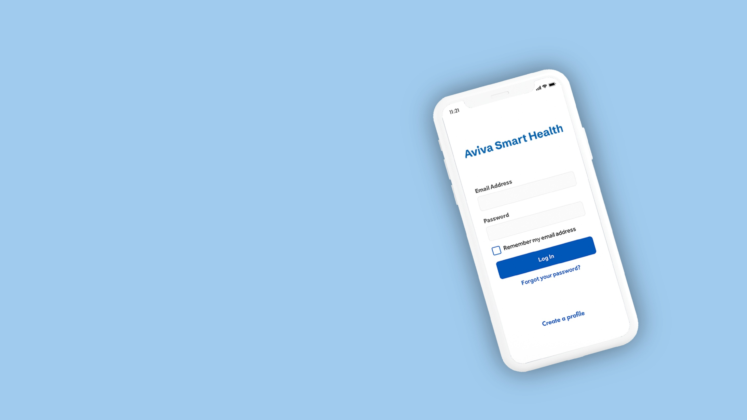
We’ve got your back with Aviva Smart Health
24/7 online GP
Second medical opinion
Mental health support
Health check
Unlimited access for insured employees – all as part of our Aviva workplace insurance
Available to you, your partner and children up to age 21
24/7, 365 days a year
Nutrition consultation
Fitness programme
Aviva Smart Health
Notes:
Notes to speaker:
Please start here if you want to dive straight in and talk about Aviva Smart Health
This is where you demonstrate the value you place on having a happy, healthy workforce − so you’ve put in place something to help take care of your people.
Aviva Smart Health is included as part of your workplace insurance with Aviva – for insured employees. As well as the financial protection (here, we’d mention what’s on offer to your people product-wise), you can sign up to and use this.
Here’s a quick overview of all six services you’ll see on screen − don’t feel like you need to read all these out. It’s just so you’re informed and have that detail to hand. Your people can use Aviva Smart Health as much as they want, whenever they want and their partner and children up to age 21 have access too.
GP: Managing your health doesn’t always fit in to the 9-5. When you need a GP appointment, you've got unlimited, round-the-clock access to a doctor. The team of UK based experts are on hand for things like medical advice, prescriptions or specialist referrals.
Second medical opinion: If you're not 100% sure on your diagnosis or treatment plan, Aviva Smart Health’s there for a second opinion. You’ll be matched with your very own GP case manager to help you through the process. Then an expert in your condition will assess your case and provide recommendations for treatment, whatever it might be.
Mental health: If you need someone to talk to, our team of qualified mental health experts are on hand for confidential support. You’ll get the specialist help you need, whether it’s how to cope with stress, anxiety, trauma or depression or dealing with a recent bereavement. There’ll be up to four sessions on offer, because that’s about the right amount according to the experts. More often than not you’ll need less than that, but don’t worry - we’re by your side every step of the way.
Online health check: Getting to know our own health is one of the most important things we can do to look after ourselves. The Aviva Smart Health team will give you personalised recommendations and next steps, based on things like your height, weight, heart health and tests and screening that might help.
Nutrition: Aviva Smart Health’s team of expert nutritionists are on hand to help you meet your goals. Their tailored weekly menus and recipe ideas will keep you on track, whether you’re trying out meat-free Mondays or need help with your portion sizes.
Fitness: Let Aviva Smart Health take the sting out of coming up with a new workout routine with your very own personalised plan. You’ll have a team of coaches and fitness experts keeping you on track, whatever your goals. Whether that’s getting back in to exercise, building upper body strength or training for a marathon.

Slide 4


It gets a pretty good write up
Aviva’s research shows how valuable this service can be, especially in a cost of living crisis.
Average value of £43 per month placed on all six services
It adds up to over £500 a year for each person that uses Aviva Smart Health
If you’re a family of four, that’s over £2,000
“GP called me very quickly and was able to recommend next steps which we have been able to use to get an NHS referral. Fantastic benefit to have through my employer.”
Aviva Smart Health customer – GP
Source: Aviva Protection UK Limited commissioned research, ID Consulting, January 2020: 2000 sample size.
Teladoc data, GP service, May 2022.
Aviva Smart Health
Notes:
Notes for speakers:
Reassure your people that you’re putting their health and wellbeing in the hands of experts − and that they’ll have access to a service people really value.
Research shows Aviva Smart Health is worth around £43 per month for all six services combined
That’s over £500 per person, per year – in a cost of living crisis, this is really important.
Remind your people that it’s not only them who can use the service, it’s available to their partner and any children up to the age of 21 too

Slide 5

Getting started
All six Aviva Smart Health services can be accessed through the app or online. It’s the same log in details for both and everything’s confidential.
Visit smarthealth.aviva.com or download the Aviva Smart Health app.
It’s as easy as 1, 2, 3
1
2
3
Time to create your very own Aviva Smart Health account. It’s a good idea to get registered straightaway, so you’re ready to go when you need it. Everyone over 18 sets up their account on their own device − any children will need to be added to a parent or guardian’s account.
Note down our company’s access code – you’ll need this when you sign up.
Access code:
[insert code here]
Have your passport or driving licence to hand when signing up for the first time. You’ll need to complete a quick ID check to make sure it’s really you using the service.
Aviva Smart Health
Notes:
Notes for speakers:
Encourage your people to get signed up then and there − so that if they need Aviva Smart Health, they’re good to go
All six services can be accessed on the app (available from Apple’s App Store and the Google Play store on Android) or via the website − people use the same log in details for both
Any children under 18 will need to be added on a parent’s profile, but any partners or older children can download the app on their own device and make their own account
You might want to have a think about using other items available on the employer hub at the end of the session − could you print copies of the leaflet as a take away, point out where the posters are in your workplace or use email template number one to send a follow up to to your people?

Slide 6
Aviva Smart Health is provided to Aviva Protection UK Limited customers by Teladoc Health. This is not part of your insurance contract and can be changed or withdrawn at any time.
Aviva Protection UK Limited. Telephone 0345 600 6820. Registered in England and Wales. Number 6367921. Registered address: Aviva, Wellington Row, York, England, YO90 1WR. Aviva Protection UK Limited is authorised by the Prudential Regulation Authority and regulated by the Financial Conduct Authority and the Prudential Regulation Authority. The registration number is 473752.
protection.aviva.com
EDCO 3963-0225

